Slide 1



Social Buzz
Analysis

Slide 2


Today's agenda
Project recap
Problem
The Analytics team
Process
Insights
Recommendations
Summary

Slide 3

Project Recap
Social Buzz is a fast-growing technology unicorn that needs to adapt quickly to its global scale.
Accenture has begun a 3 month POC focusing on these tasks:
An audit of Social Buzz’s big data practice.
Recommendations for a successful IPO.
Analysis to find Social Buzz’s top 5 most popular categories of content.

Slide 4

J
Problem
Over 100000 posts per day
36,500,000 pieces of content per year.
But how to capitalize on it when there is so much?
Analysis to find Social Buzz’s top 5 most popular categories of content.

Slide 5



Our Team
Andrew Fleming (Chief Technical Architect), Marcus Rompton (Senior Principle)
Karuna Kesavan Kothandath

Slide 6
Process
Data Understanding
1
2
Data Cleaning
Data Modelling
3
4
Data Analysis
Uncover Insights
5

Slide 7

Insights
16
1897
JANUARY
Unique
Categories
Reactions to “Animal”
Posts
Month with
Most Posts

Slide 8
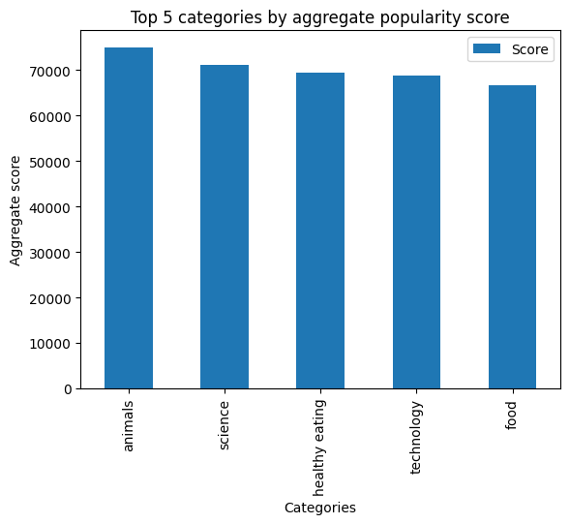

Slide 9
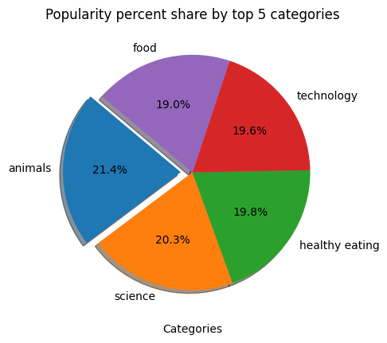

Slide 10

In analyzing the top-performing content categories on Social Buzz, we discovered that Animals, Healthy Eating, Science, Technology, and Food emerged as the leading areas of user engagement. With a total score of 350,886, the data indicates a clear preference for content that resonates with users’ interests and values.
The highest engagement in the Animals category suggests a strong community interest that can be leveraged for educational and conservation-focused initiatives. Healthy Eating and Food categories highlight the growing demand for nutritious content, offering opportunities for interactive challenges and collaborations with culinary influencers.
Meanwhile, the Science and Technology categories reveal a keen appetite for educational content and innovation, suggesting that ongoing updates and partnerships could enhance user engagement further.
Overall, by focusing on these top categories and understanding user reactions, Social Buzz can create targeted content strategies that not only attract but also retain a diverse audience, ultimately driving greater engagement and satisfaction on the platform.
Summary

Slide 11
Thank you!
ANY QUESTIONS?

